Slide 1
AUTONOMOUS SOCCER ROBOTS
By Kai Sugrue
Anand Parab
Stephen Wan
Brandon Liu
Lucas Zapata-Sanin
Notes:
Kai

Slide 2

THE MONTAGE!!
Notes:
Brandon

Slide 3
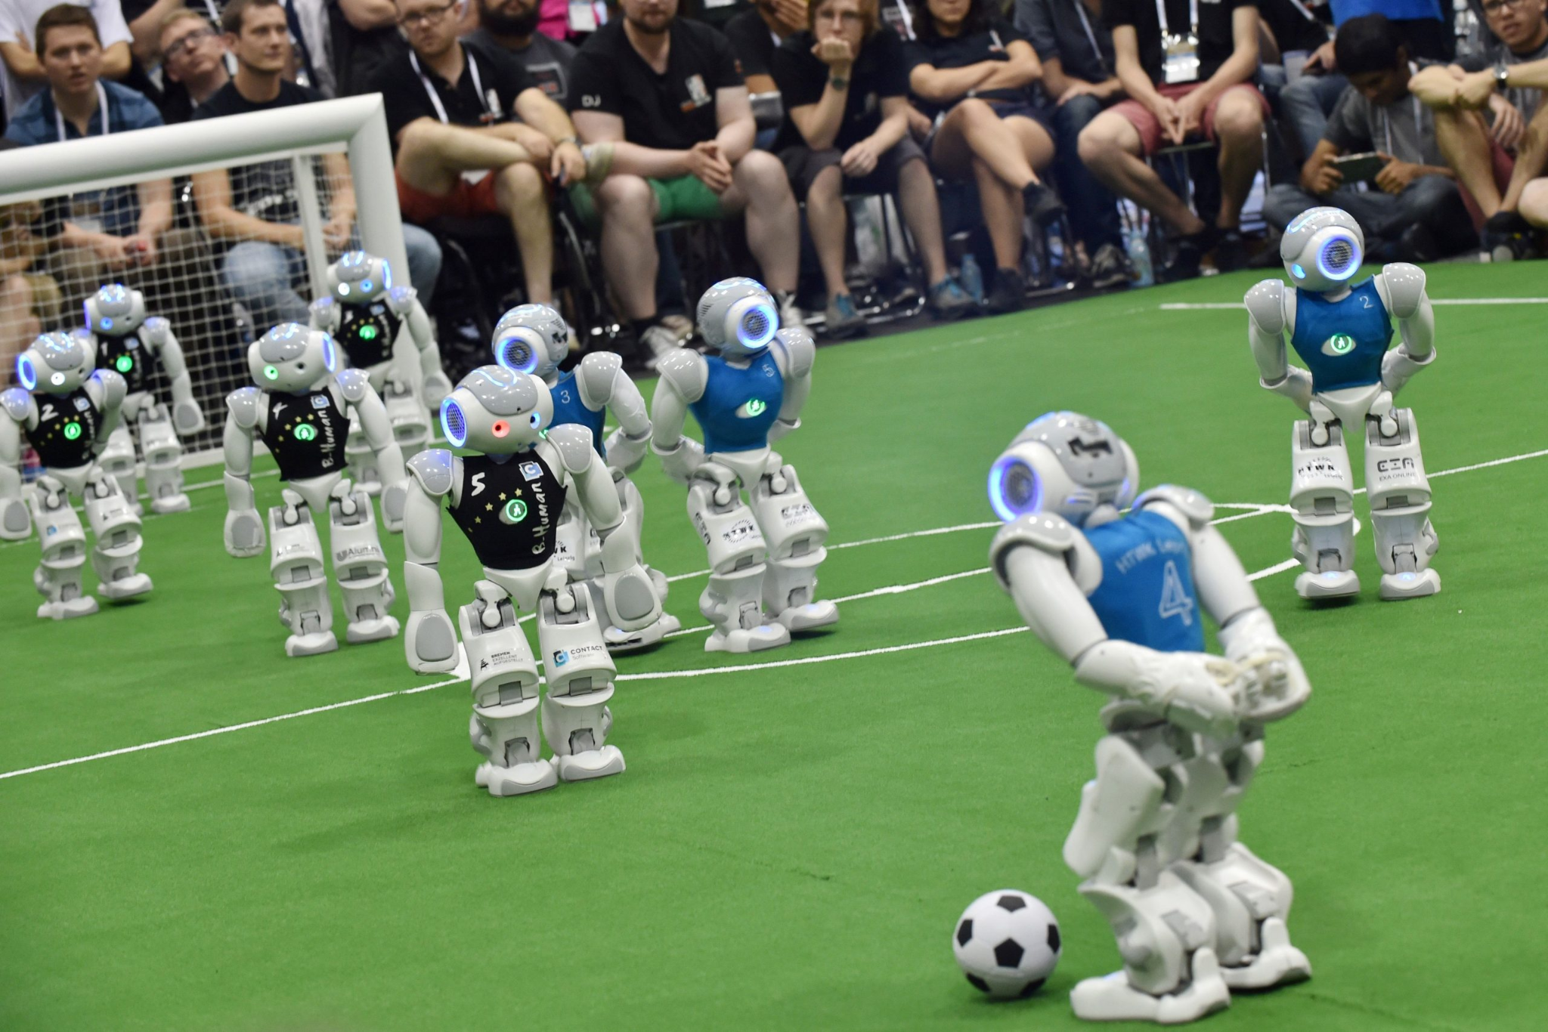

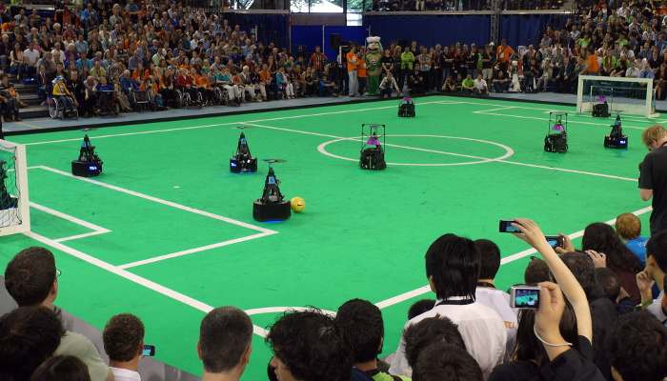
What is Robocup (Organization)
Annual International robotics competition
Focused on Soccer-playing robots and advancing robotics and AI research
Hosts a competition for a variety of age levels as different leagues.
Notes:
Brandon

Slide 4
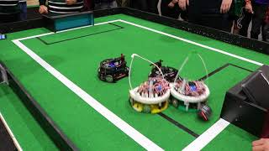

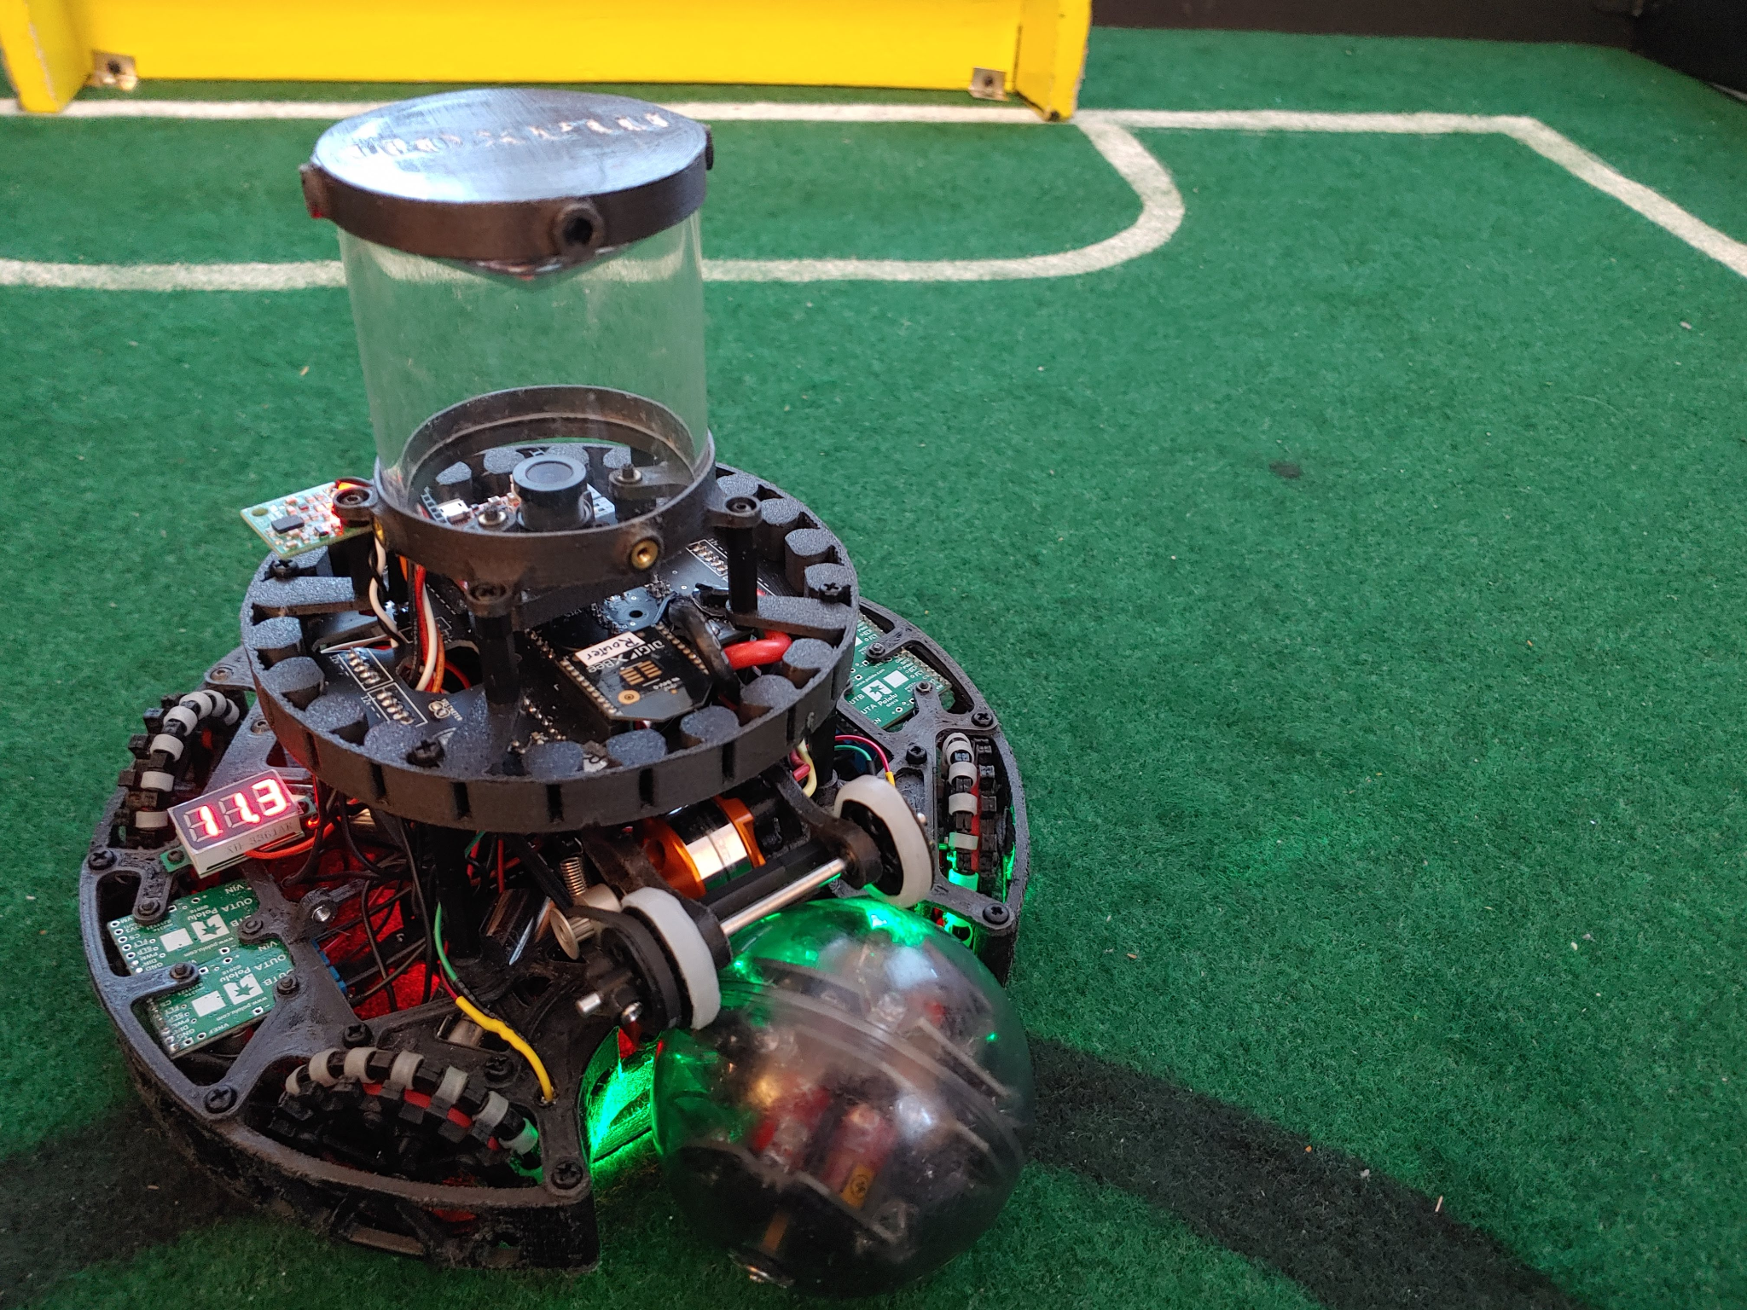
Our League: Robocup Junior Lightweight
Highschool League - Small scale version
Robots that can traverse and follow a ball and score goals.
COMPLETELY AUTONOMOUS robot, meaning that ONLY the code controls it.
Notes:
Brandon

Slide 5
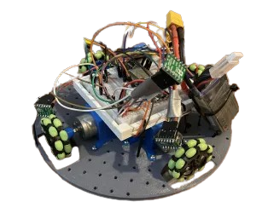
Prototyping - Sept. -> Oct.
Breadboard
Battery
Wheels
Motor Driver
Motors
Notes:
Lucas

Slide 6
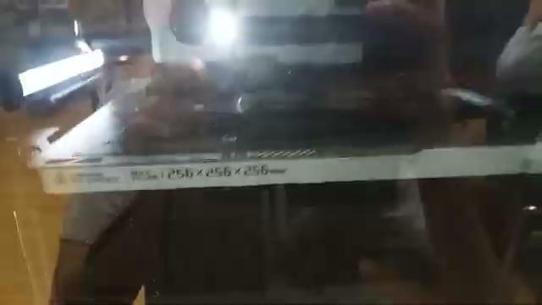
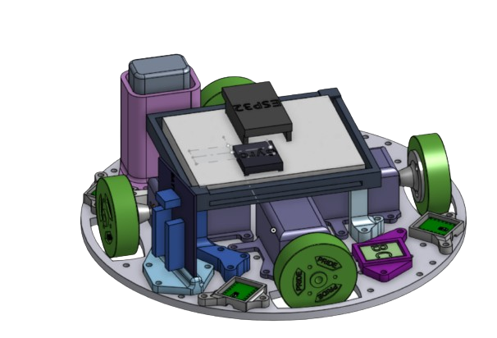
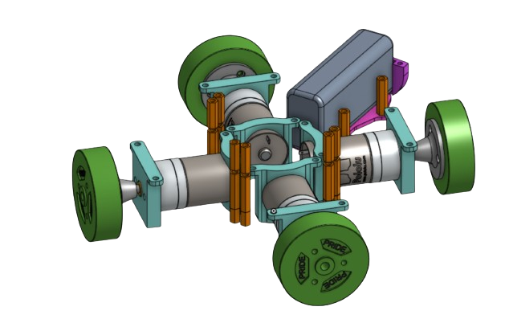
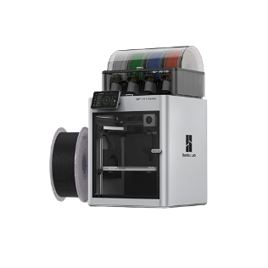
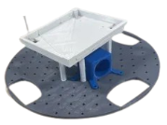
Prototype CAD (Computer Aided Design)
Notes:
Lucas

Slide 7

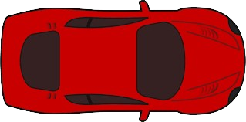
OMNI
Notes:
Lucas

Slide 8
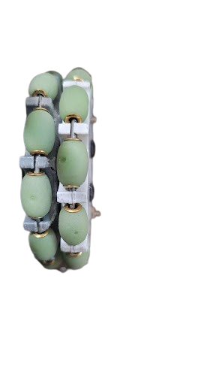
OMNI
Notes:
Lucas

Slide 9
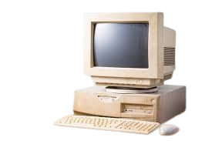
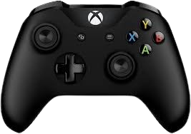

Human Control (Fun Side Quest)
VROOM VROOM !
Notes:
Stephen

Slide 10
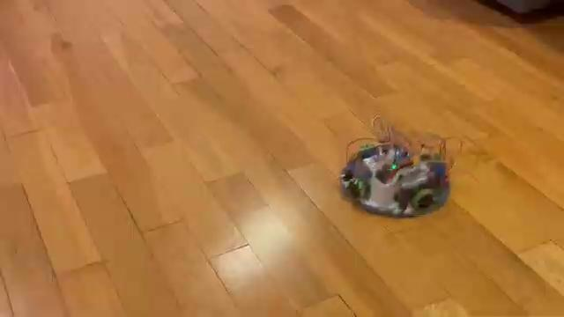
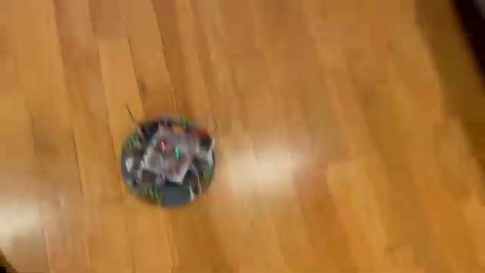
Prototyping
Notes:
Stephen

Slide 11
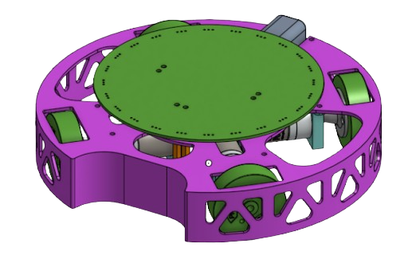

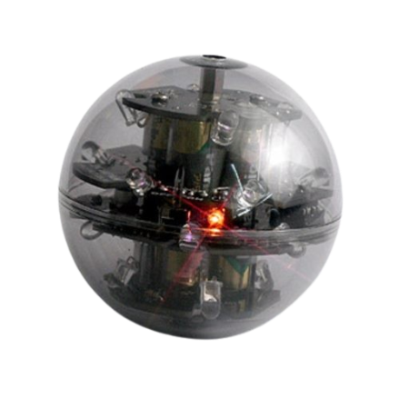
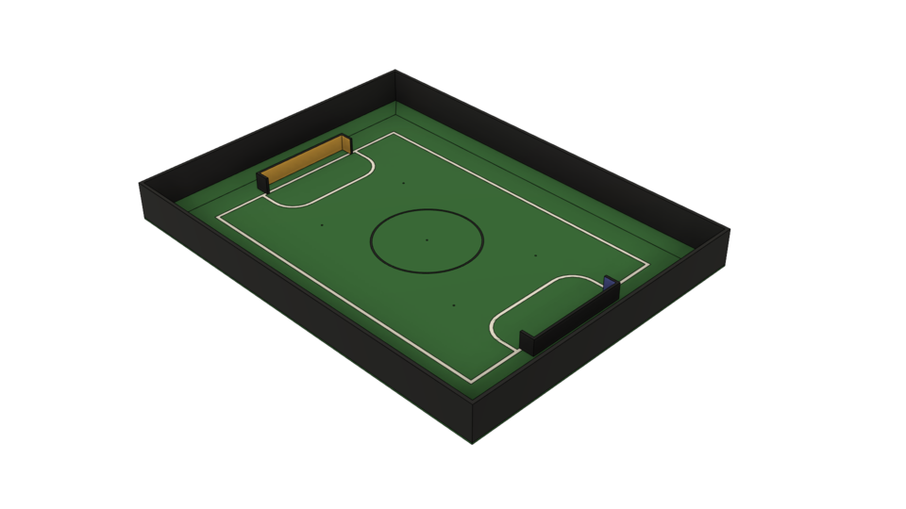
It DRIVES! What’s next?
BIG Problem: IT CAN’T PLAY SOCCER!
1) IT CAN’T SEE!
No sensors
2) Wires can get knocked out of place
3) Can’t push ball
BALL
LINES
Notes:
Anand

Slide 12
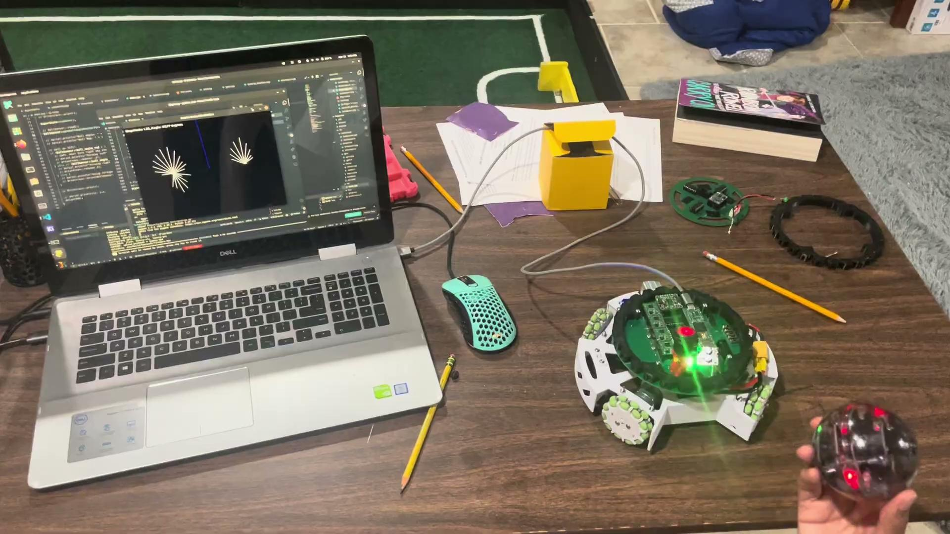
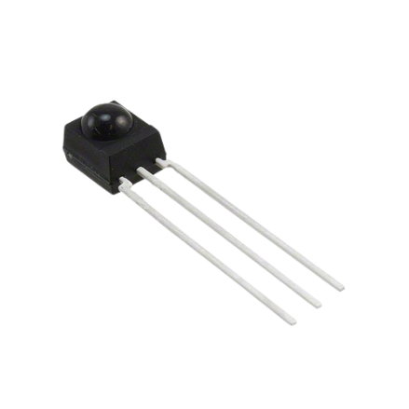
THE BALL?
INFRARED LIGHT (IR)
IR RECEIVER
Notes:
Anand

Slide 13
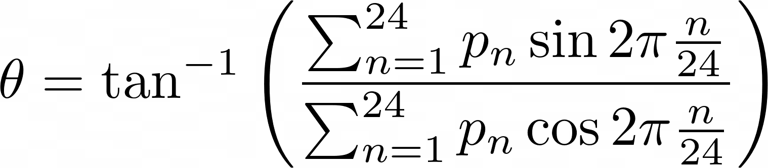
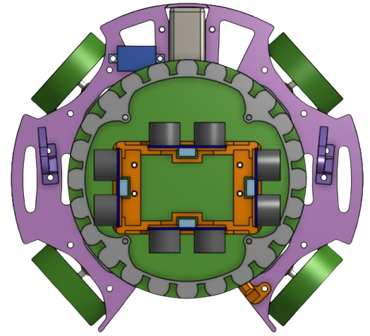
“hey what if we add up all of these arrows”
― someone smart maybe
Notes:
Anand

Slide 14
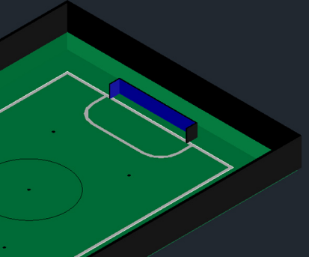
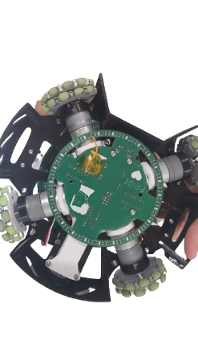
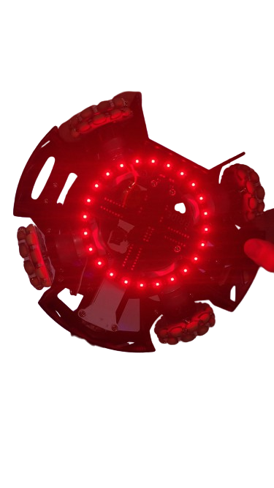
WHERE ARE THE LINES?
LINE PCB
LED
photodiode
Value: ~400 Value: ~800
LED
LED
photodiode
photodiode
Carpet
White Line
Notes:
Kai

Slide 15

Calibration
Each Field is different…
Different green ink,
Different white paint,
Different lighting,
Etc.
Every line sensor reads same part of the carpet differently.
Calibrating robot before each match.
Sensors read values on green and white.
Average difference to set sensor thresholds.
Values above threshold indicate white line.
Notes:
Anand

Slide 16
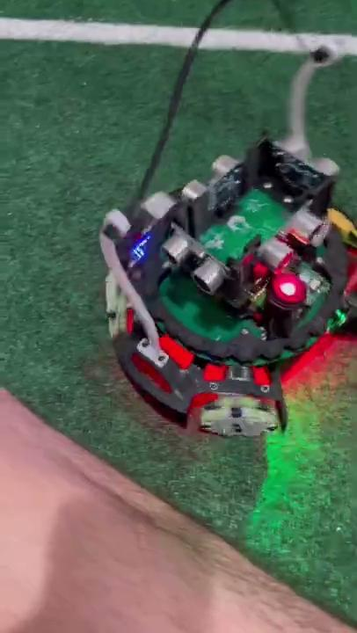
Calibration
ON CARPET
550 (maximum value)
WHITE LINE
700 (maximum value)
(ON CARPET + WHITE LINE)
-------------------------------------
2
(550+700)/2 = 625
Notes:
Anand

Slide 17
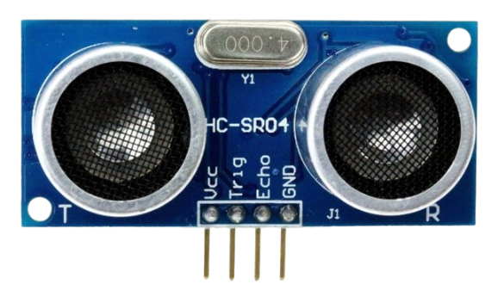
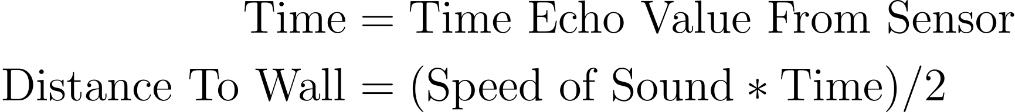
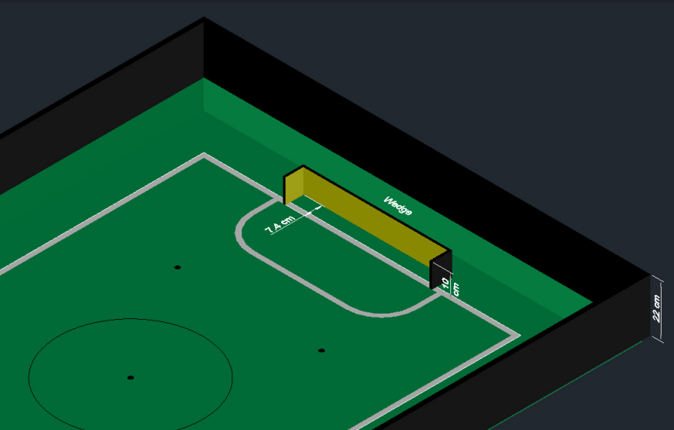
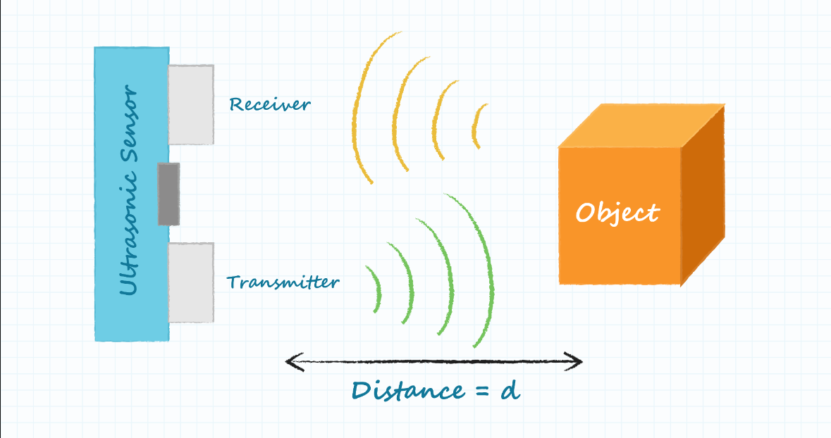
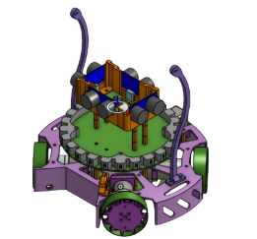
WHERE ARE WE?
Ultrasonic
Notes:
Kai

Slide 18
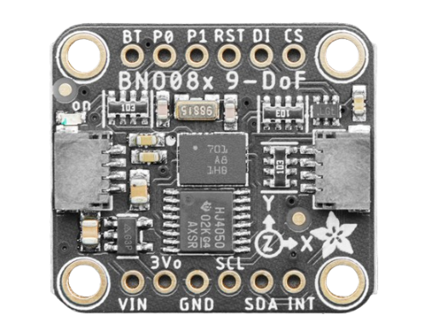
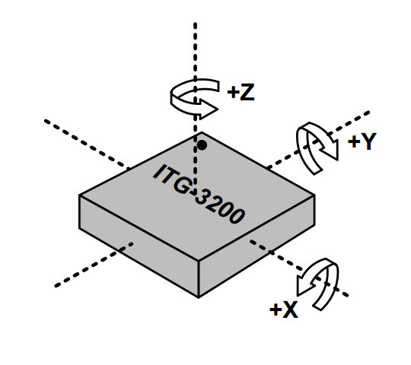
WHERE IS FORWARD?
Gyroscope
Notes:
Kai

Slide 19
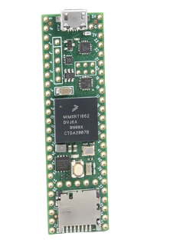
PROCESSING?
Criteria
Handle tons of data and information from sensors
Calculate thousands of calculations a second
Small and compact
Teensy 4.1
-> similar to Arduino
-> Capable of handling 1.2 billion operations a second
Notes:
Kai

Slide 20
MAJOR PROBLEM 2: WIRES!
200+ connections
LED
photodiode
Gyroscope
24x LEDs
24x Photodiodes
24x Line sensors
4x Ultrasonic
Notes:
Kai

Slide 21
MAJOR PROBLEM 2: WIRES!
~30 connections
200+ more connections
53 sensors
Precise sensor locations
Notes:
Kai

Slide 22
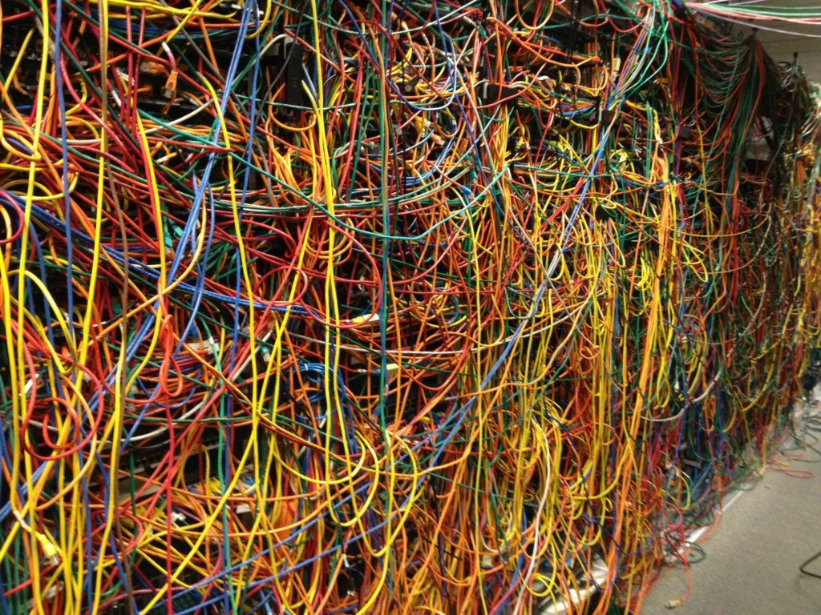
MAJOR PROBLEM 2: WIRES!
~230 connections connections
7x the connections: THE SAME SPACE
~30 connections
One wire disconnects…
Notes:
Kai

Slide 23
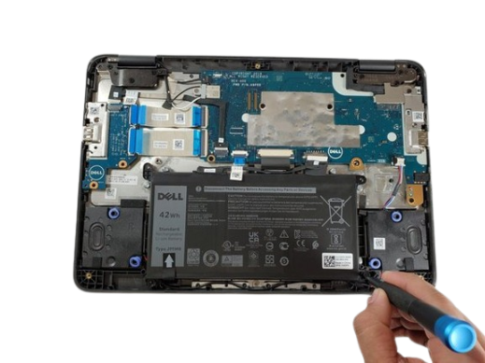
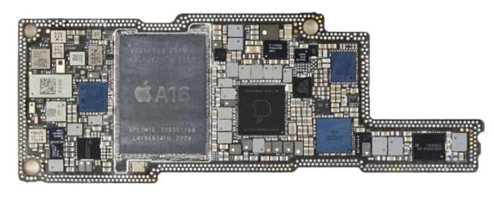
SOLUTION: Printed Circuit Boards(PCB)
IPhone 14
School Chromebook
Compact
Clean
Easily replaceable
Notes:
Kai

Slide 24

Chassis Redesign
ULTRASONIC PCB
(detect walls)
MAIN PCB
(microcontroller,
IR SENSORS)
LINE PCB
(line detection sensors)
Notes:
Kai

Slide 25

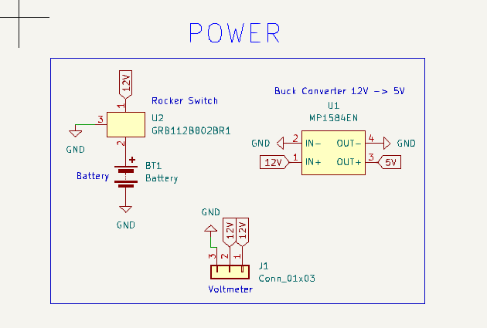
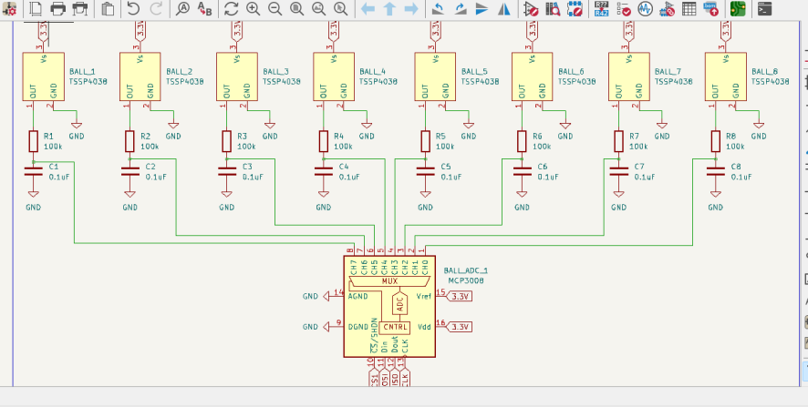
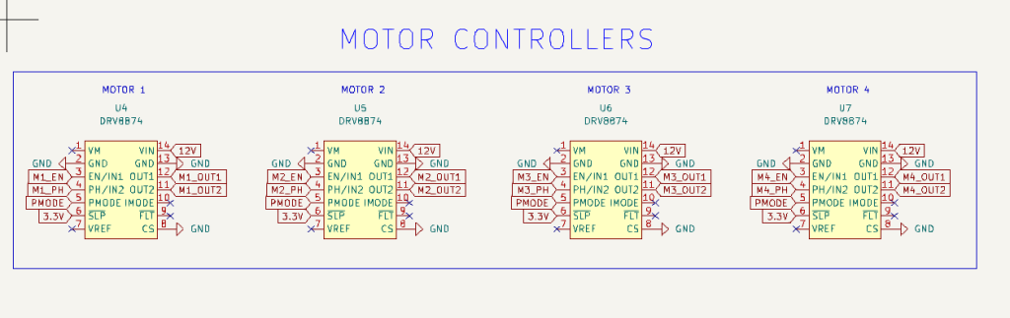
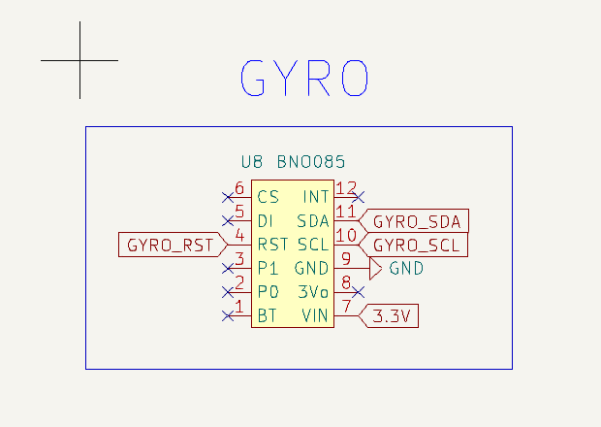
Schematics
Notes:
Kai

Slide 26
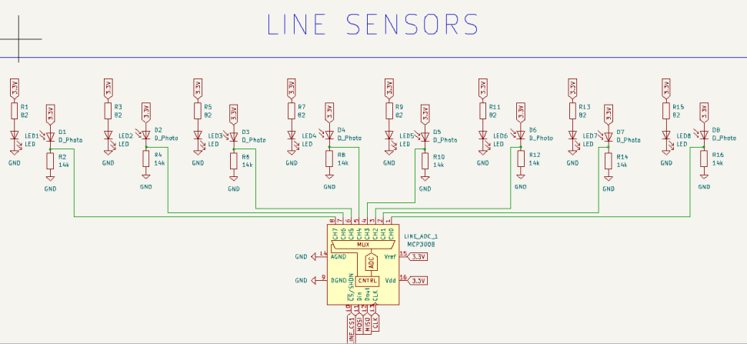
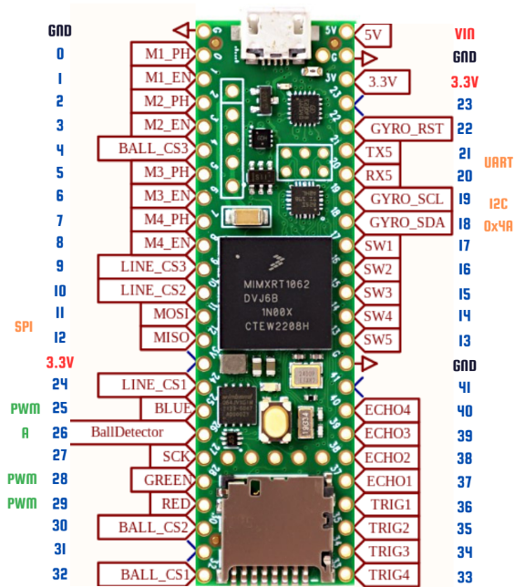
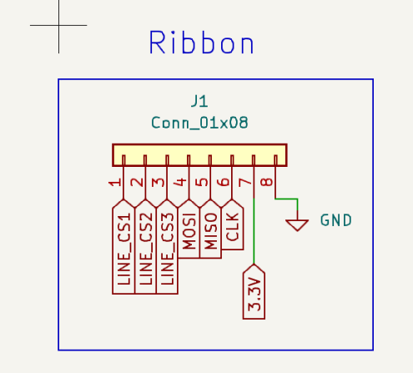
Schematics
Notes:
Kai

Slide 27
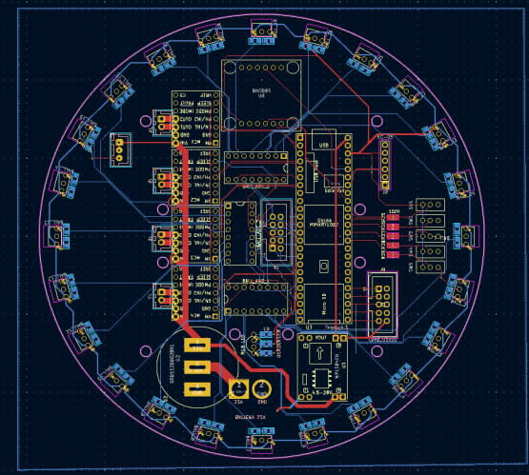
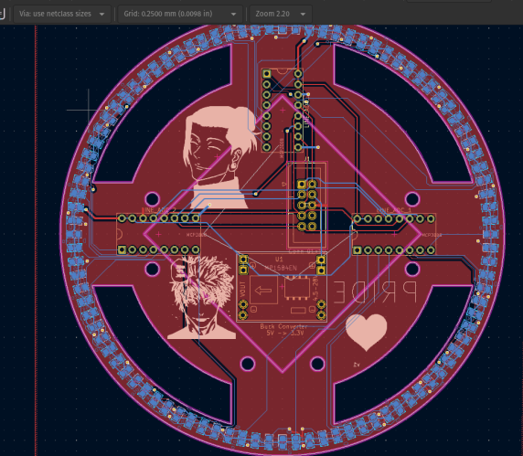
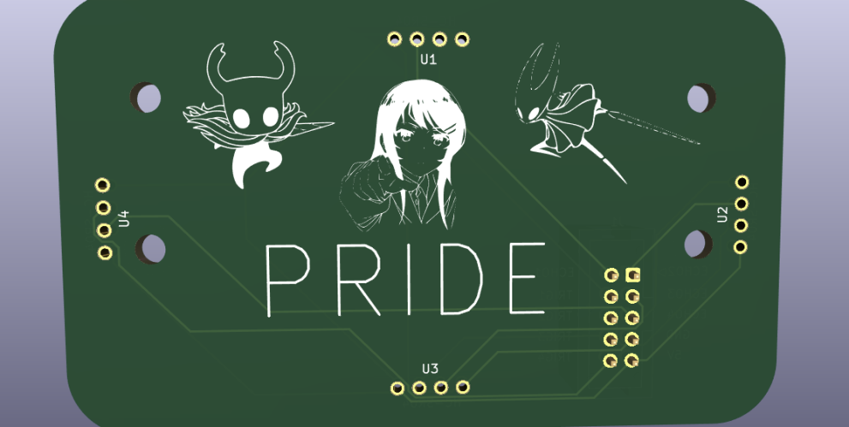
Designing
Ultrasonic PCB
Main PCB
Line PCB
Notes:
Kai

Slide 28
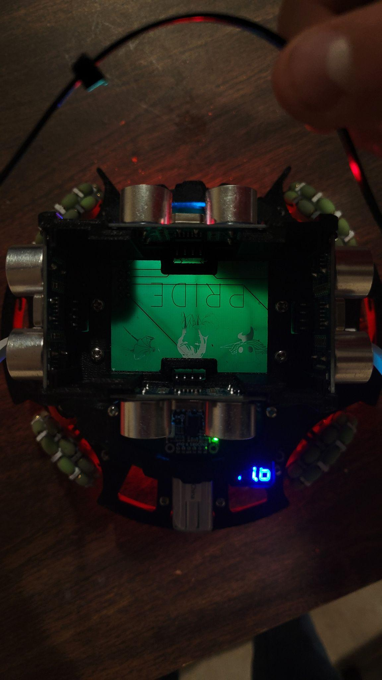
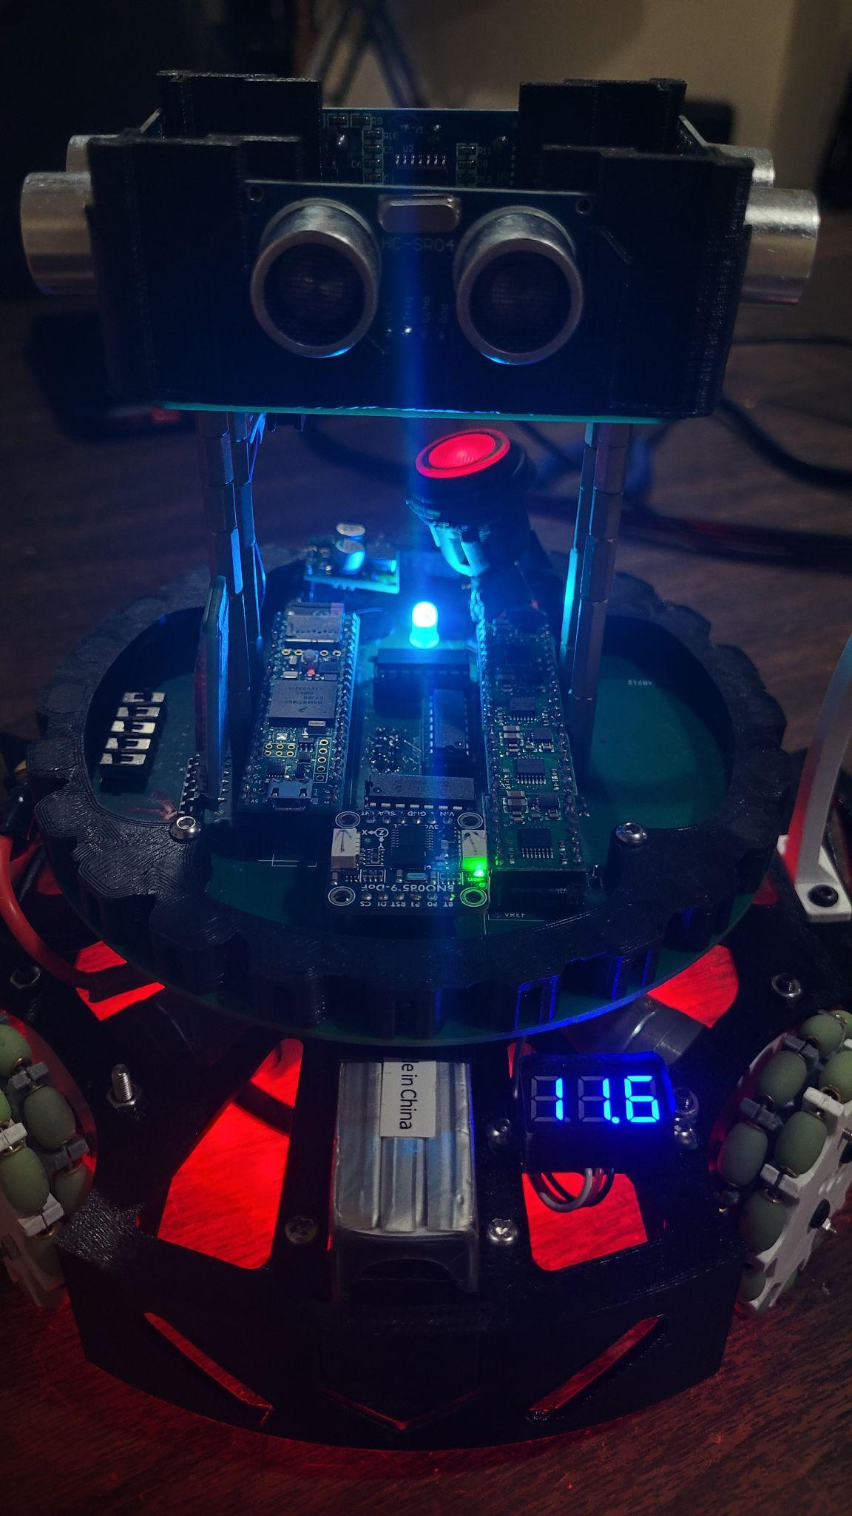


We created PCBS!
Mounted
Components
Ultrasonic PCB
Main PCB
Notes:
Kai

Slide 29



MAJOR PROBLEM 3: CONTROLLING BALL
Notes:
Anand

Slide 30


More Problems Encountered!
Line Sensors didn’t read good values
Ball Capture Zone Too Small
No Handle
Notes:
Anand

Slide 31




Line Sensors Got Bad Readings
LINE PCB
LED
~7mm
photodiode
Original
New
45mm
9 beads
54mm
11 beads
Notes:
Anand

Slide 32

Ball Capture Zone Enlarged
Notes:
Lucas

Slide 33


No Handle
Notes:
Lucas

Slide 34






Chassis Evolution
Prototype
Oct -> dec.
Outer wheels
Mar -> April
Bigger goal
April
Inner wheels
Jan-> Mar
Today
Notes:
Lucas

Slide 35


PLA → PETG
PETG better elasticity
Higher resistance to shock loading
PETG higher impact strength
Reduced risk of fracture
PETG higher hardness
Less abrasion
withstand the effects of friction, rubbing or grazing over time.
Notes:
Lucas

Slide 36


Gameplay Algorithms
Attack
Defense
Notes:
Brandon

Slide 37

Simple Attack Algorithm
Notes:
Brandon

Slide 38
Complex Attack Algorithm
Notes:
Brandon

Slide 39


Line Bouncing
Movement
Vector
Line Vector
Line Vector
Movement Vector
Notes:
Brandon

Slide 40


Side Stepping
Notes:
Brandon

Slide 41


Basic Defense Algorithm
Sitting there as a roadblock
Notes:
Stephen

Slide 42
Complex Defense Algorithm
On the line to get relative position to field
Following the ball!
Notes:
Stephen

Slide 43
Edge Case #1
Sit on the corner when the ball isn't in front of the goal. Also by leaving the line, the robot isn't guarding anything.
Notes:
Stephen

Slide 44

Edge Case #2
When the robot isn’t on the line, it needs to get back ASAP!
To know how to get back, it needs to know where it is.
To do this it uses Ultrasonic Sensors.
Notes:
Stephen

Slide 45
Edge Case #3
Huh? I’m really close to the edge and my Line Vector isn't pointing forwards or backwards. Something must be wrong.
The robot is on the line but the wrong line.
Notes:
Stephen

Slide 46
LIVE DEMO
Notes:
Anand

Slide 47




Inspiration/Research
Team OI_DENGIKEN
Team Radian
Team Orion

Slide 48

Final Weight
1.2kg

Slide 49


Slide 50


